Slide 1
Data assimilation
H. Heorton & P. Lewis
https://link.springer.com/chapter/10.1007/978-81-322-2547-8_4

Slide 2
Data assimilation
What is DA?
What does DA do? Why do we do it?
What does it achieve?
Examples:
Toy model
General DA concepts
Quaife et al. 2008
Sequential technique – Kalman Filter
MacBean et al. 2018 (Orchidee, SIF)
Variational technique – using cost functions

Slide 3
Models and measurement
Suppose we have a model parameterized by state variables x
e.g. Vcmax, Tmin etc.
And the model that predicts some quantity y for given x
and driving variables, T, IPAR, …
e.g. y might be daily C flux
If we have some measurements of y, we want to use them to improve model prediction
How can we do that?

Slide 4
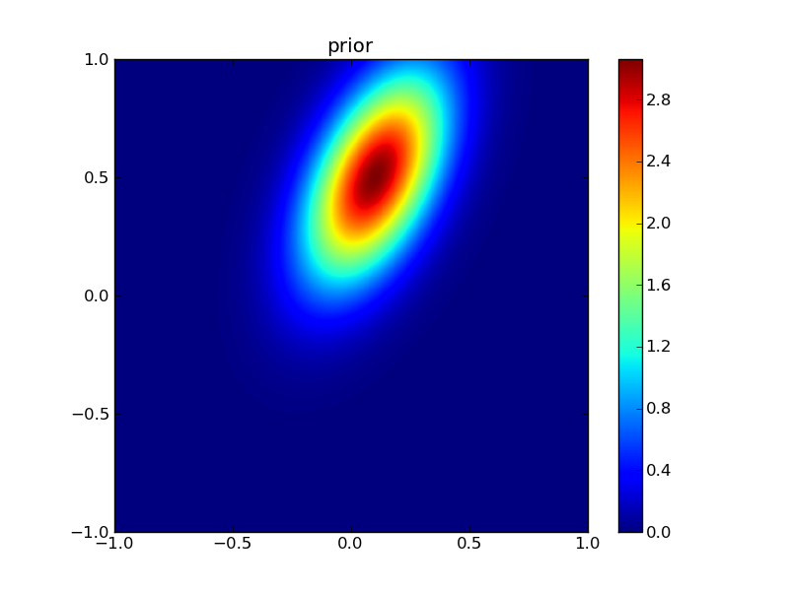
Toy model: ‘model inversion’ view
1. Take measurement of y
2. Given parameters x=[x₀,x₁], make model prediction of y, y_{hat}
x₁
3. Define and calculate discrepancy metric J=|y-y_{hat}|_{N}
4. Vary model parameters x, and calculate J at each point
x₀
5. Find ‘optimal’ solution, i.e. arg min_{x} (J)

Slide 5
Multiple constraints
Often, not enough information in observations
‘Under constrained’, ‘;poorly conditioned’, ‘ill-posed’
We might have multiple constraints on a solution
Observations
Model of physical process
Empirical models (e.g. smoothness)
Prior information
We should seek a ‘balanced’ solution based on these

Slide 6
What is Data Assimilation?
A set of techniques to combine data with some underlying process model to provide optimal estimates of the true state and/or parameters of that model.

Slide 7
What is Data Assimilation?
It is not just model inversion.
But could be seen as a process constraint on inversion (e.g. a temporal constraint)
https://climatedataguide.ucar.edu/climate-data/simplistic-overview-reanalysis-data-assimilation-methods

Slide 8
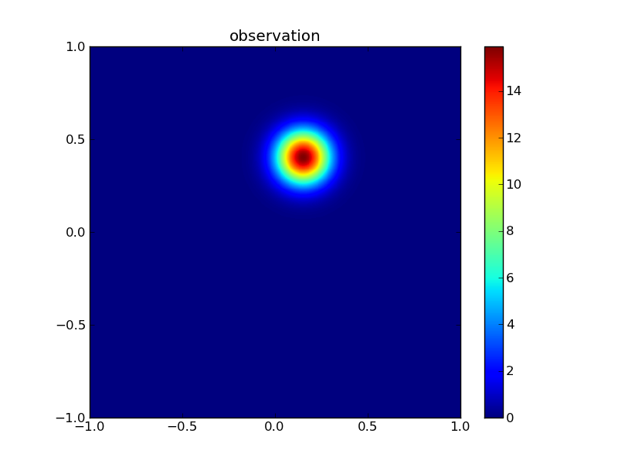
Toy model: Uncertainty
We must treat all information as uncertain
Define PDF for observations, parameters
Describe model uncertainty, driver uncertainty
And account for all of these

Slide 9
Data Assimilation is Bayesian
Bayes’ theorem:
P(A|B) | = | P(B|A) P(A)
 |  | P(B)
Intro to DA with EO : Lahoz & Schneider (2014)

Slide 10
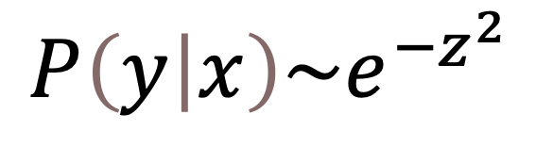
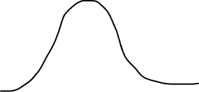

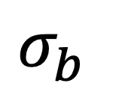
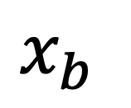
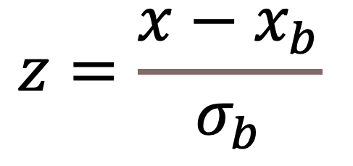
Gaussian (Normal) distribution
$$z=\frac{x−x_{b}}{σ_{b}}$$
$$σ_{b}$$
$$x_{b}$$
$$P\left(y | x\right)\sim e^{−z^{2}}$$

Slide 11
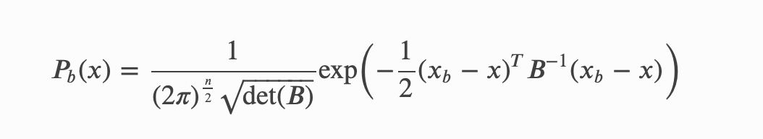
Toy model: multivariate
Identify the terms here: B, n, x_{b}

Slide 12

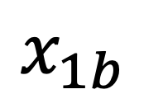
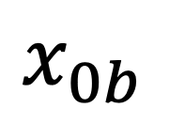

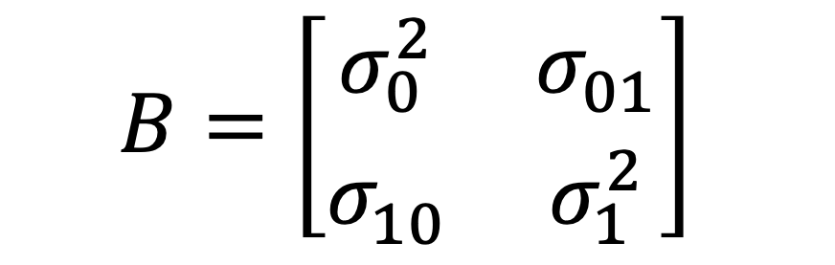
multivariate
Identify the terms here: B, n, x_{b}
$$x=\left[\begin{matrix}x_{0b} \\ x_{1b}\end{matrix}\right]$$
$$x_{b}=\left[\begin{matrix}{\overline{x}}_{0b} \\ {\overline{x}}_{1b}\end{matrix}\right]$$
$$x_{1b}$$
$$B=\left[\begin{matrix}σ_{0}^{2} & σ_{01}^{} \\ σ_{10}^{} & σ_{1}^{2}\end{matrix}\right]$$
$$x_{0b}$$

Slide 13
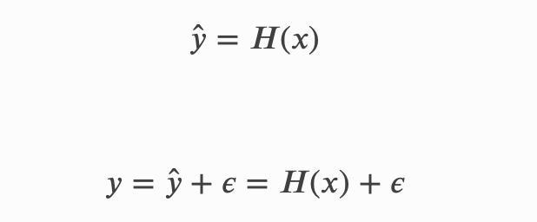

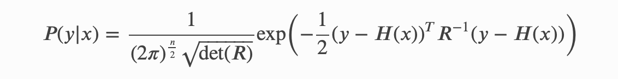
observation

Slide 14
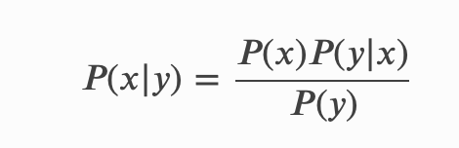
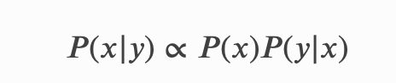
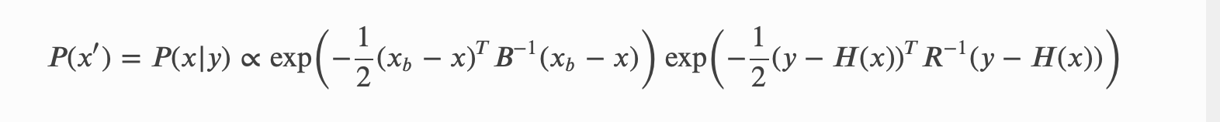
update

Slide 15


Slide 16
What does DA aim to do?
Use all available information about
A Priori information
The underlying model
The observations
The observation operator
Including estimates of uncertainty and the current state of the system
To provide a best estimate of the true state of the system with quantified uncertainty

Slide 17
Quaife et al. 2008
Quaife et al.
Seek to use EO observations
MODIS reflectance over time
To improve C flux estimates
Spatially
Approach:
Model of C flux (DALEC)
H(x) is radiative transfer for forests (GORT)
Kalman filter

Slide 18
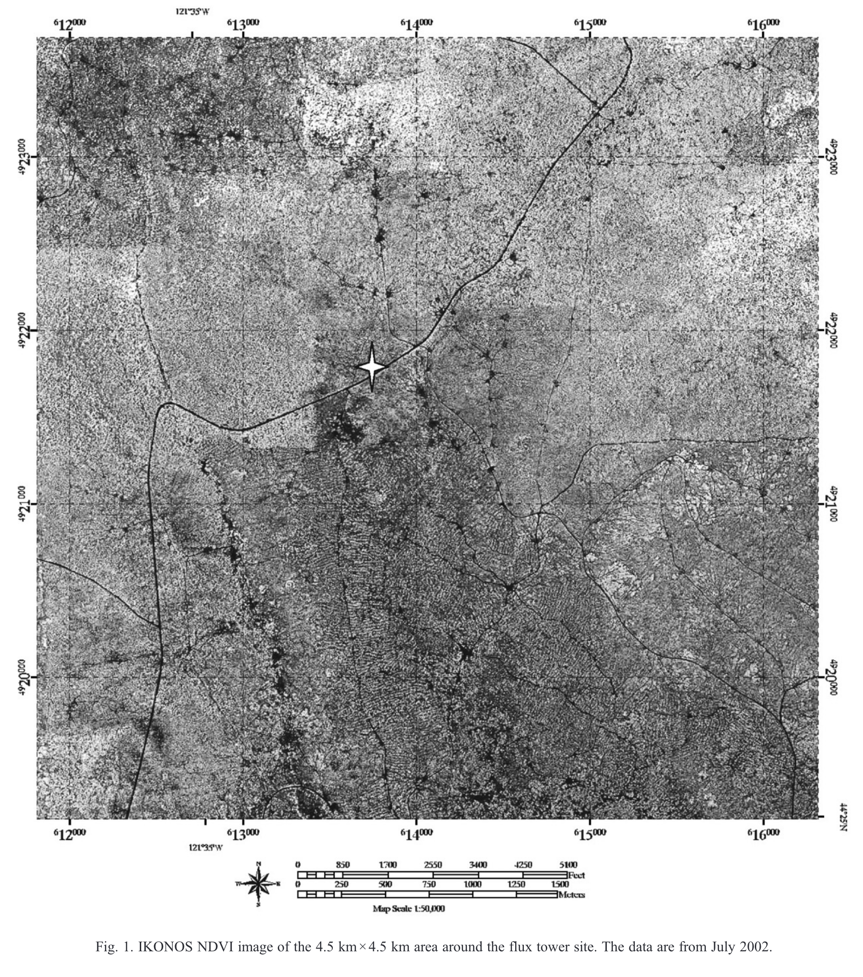
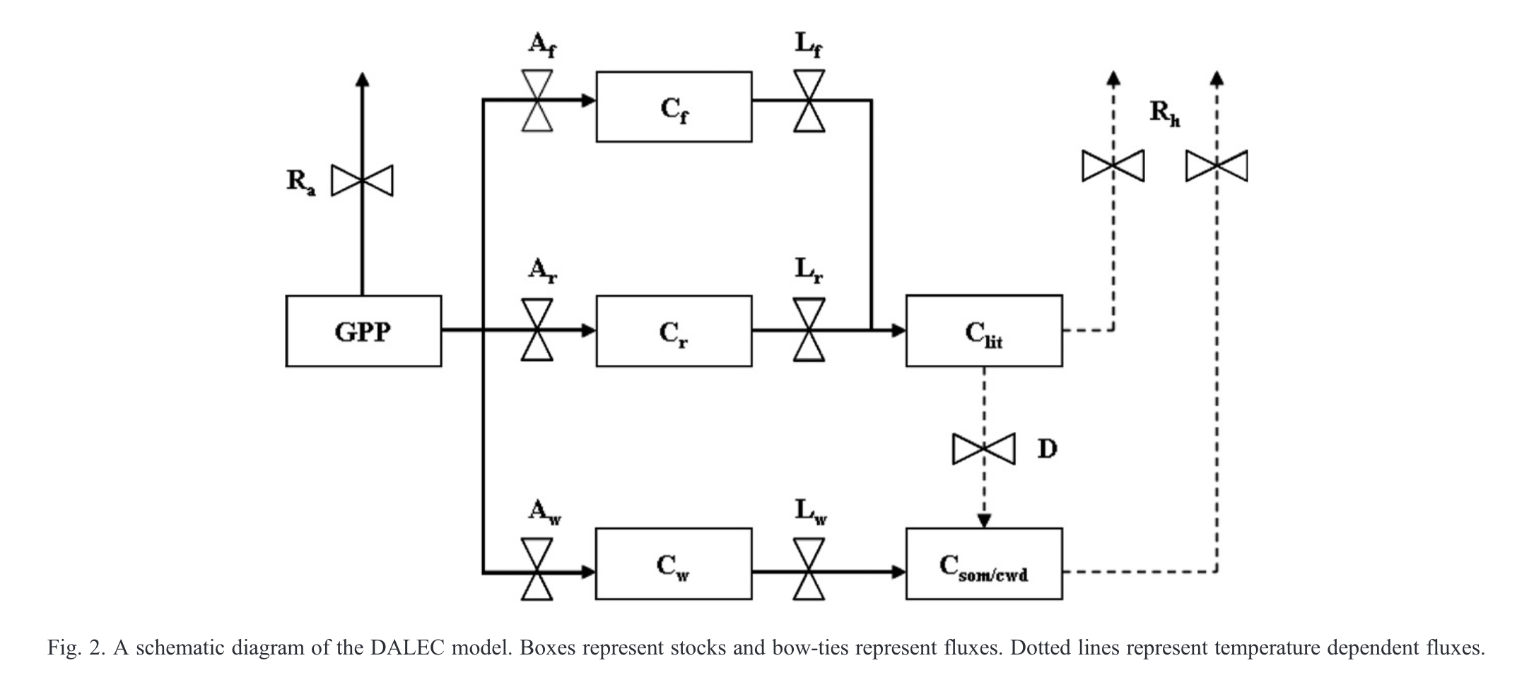
Quaife et al. 2008
We have regular satellite surface reflectance data
We can map surface reflectance to LAI (observation operator)
We have a model than includes this variable
There is additional data from a flux tower to validate against

Slide 19
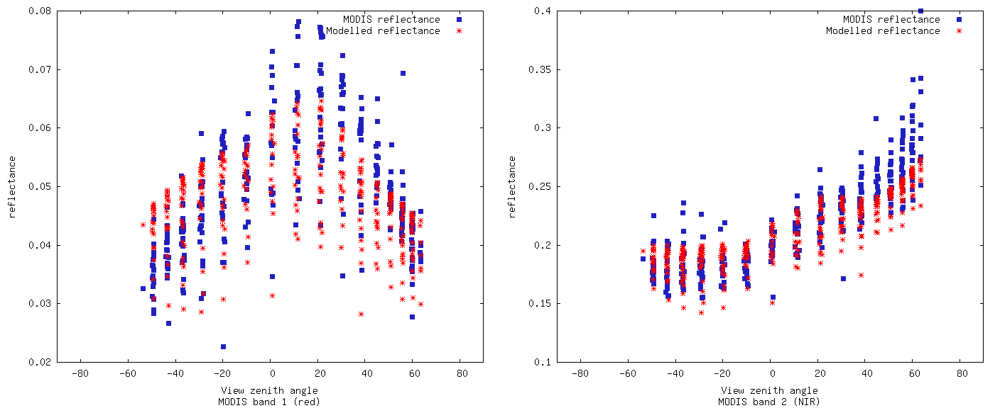
Quaife et al. 2008: Modelled vs. observed reflectance
Red
NIR
Note BRF shape in red: can’t simulate with 1-D canopy (GORT here)

Slide 20
Quaife et al. 2008: The Kalman Filter
Linear process model
Linear observation operator
Assumes normally distributed errors

Slide 21
Quaife et al. 2008: The Kalman filter
Propagation step:
x = Mx⁻
P = MP⁻M^{T} + Q
Analysis step:
x* = x + K( y – Hx )
K = PH^{T}( HPH^{T}+R )⁻¹
Observation operator
Model
Covariancematrix
Stochastic forcing
Kalman gain
Observation covariance matrix
State vector
Observation vector

Slide 22
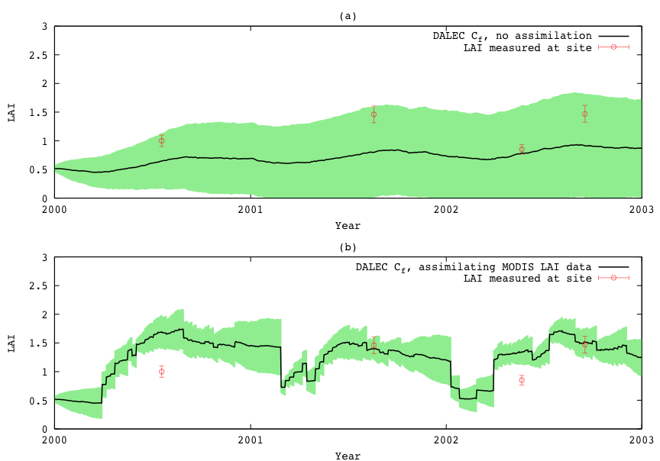
Quaife et al. 2008: Kalman Filter DA
Data assimilation into DALEC ecological model: Quaife et al. 2008

Slide 23
The Extended Kalman filter
Propagation step:
x = m(x⁻)
P = M'P⁻M'^{T} + Q
Analysis step:
x* = x + K( y – h(x) )
K = PH'^{T}( H'PH'^{T}+R )⁻¹
Jacobian matrix
Jacobian matrix

Slide 24
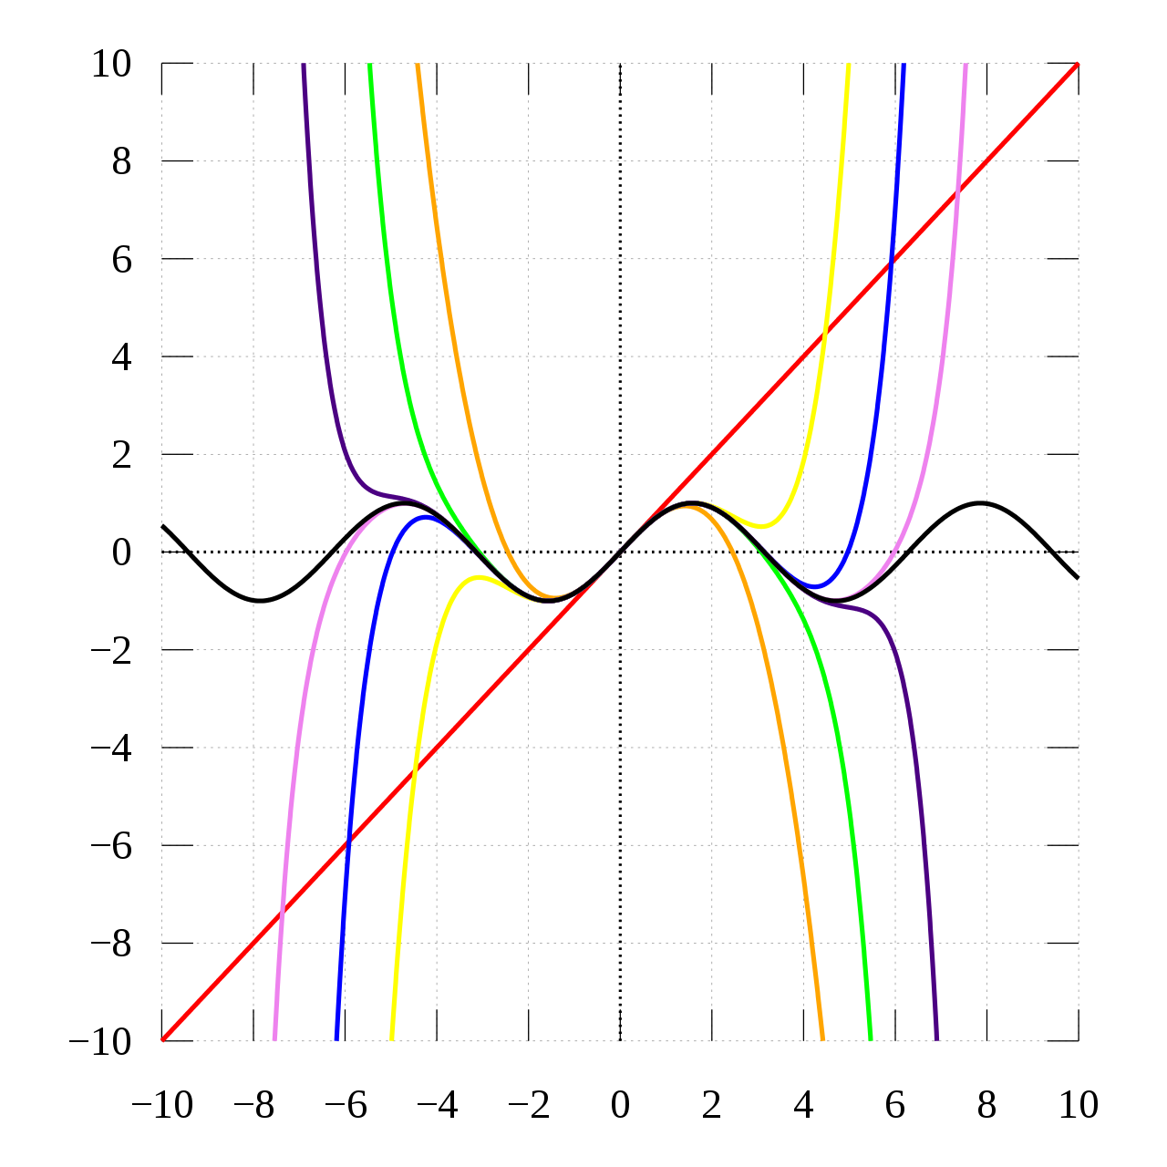
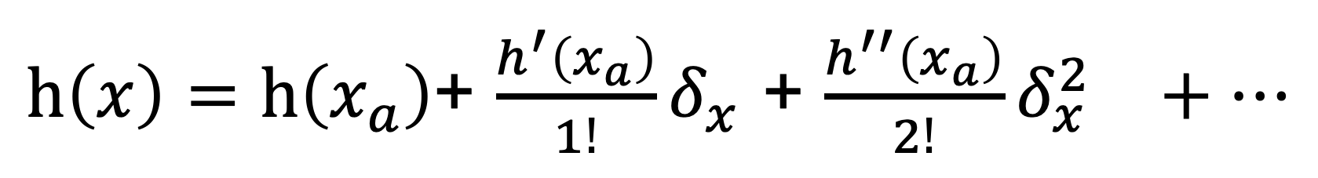
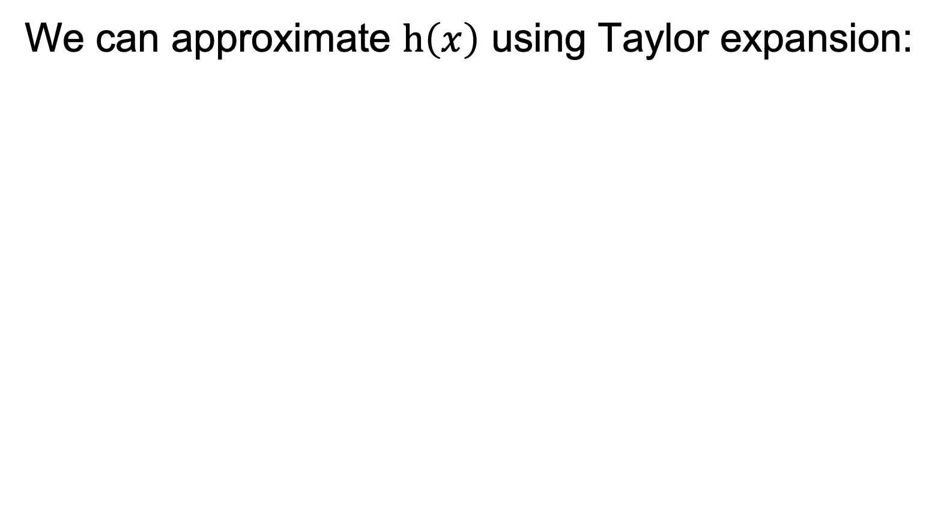
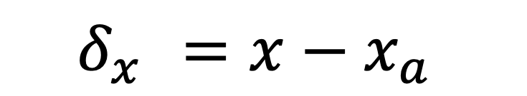
Linear approximation to function
We can approximate $h\left(x\right)$ using Taylor expansion:
$h\left(x\right)=h\left(x_{a}\right)$+ $\frac{h^{′}\left(x_{a}\right)}{1!}δ_{x}^{}$+ ${\frac{h^{′′}\left(x_{a}\right)}{2!}δ_{x}^{2}}^{}+…$
$$δ_{x}^{}=x−x_{a}$$

Slide 25
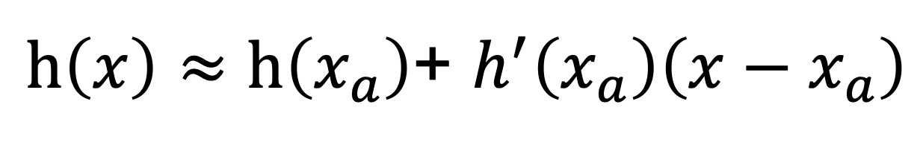
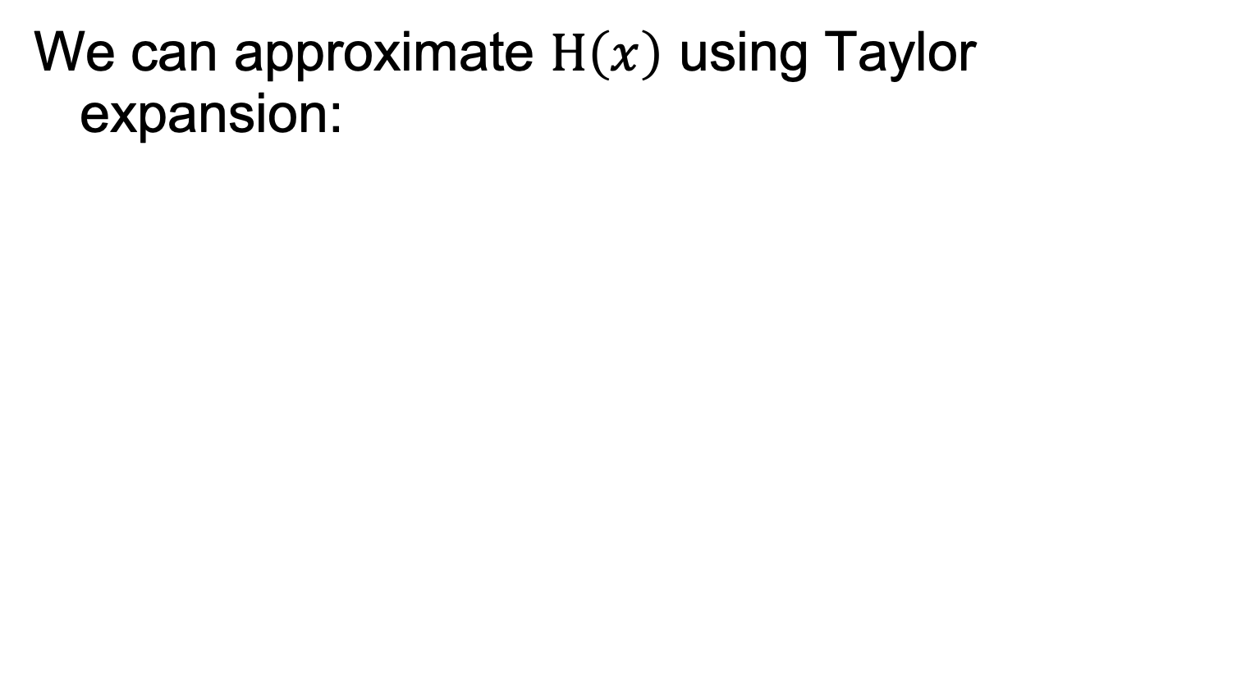
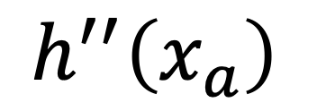
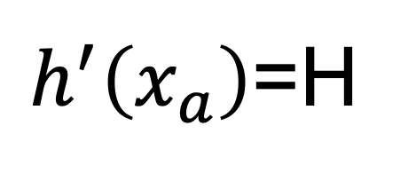
Linear approximation to function
We can approximate $H\left(x\right)$ using Taylor expansion:
$h\left(x\right)≈h\left(x_{a}\right)$+ $h^{′}\left(x_{a}\right)\left(x−x_{a}\right)$
Jacobian matrix
$h^{′}\left(x_{a}\right)$=H
Hessian matrix
$$h^{′′}\left(x_{a}\right)$$

Slide 26
The Extended Kalman Filter
Linear process model
Linear observation operator
Assumes normally distributed errors
Problem with divergence

Slide 27
The Ensemble Kalman filter
Propagation step:
X = m(X⁻) + Q
no explicit error propagation
Analysis step:
X* = X + K( D – HX )
K = PH^{T}( HPH^{T}+R )⁻¹
State vector ensemble
Perturbed observations

Slide 28
The Ensemble Kalman Filter
P estimated from X
Non linear observations using augmentation:
Xª = h(X)
X

Slide 29

Quaife et al. 2008: Mean NEP for 2000-2002
EO data: spatial DA
Flux Tower
4.5 km
Spatial average = 50.9
Std. dev. = 9.7
(gC/m²/year)
15
65
gC/m²/year

Slide 30
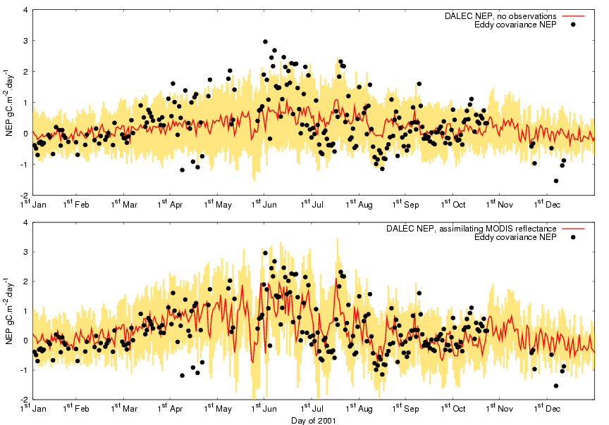
Quaife et al. 2008: The Ensemble Kalman Filter
No assimilation
Assimilating MODIS surface reflectance bands 1 and 2

Slide 31
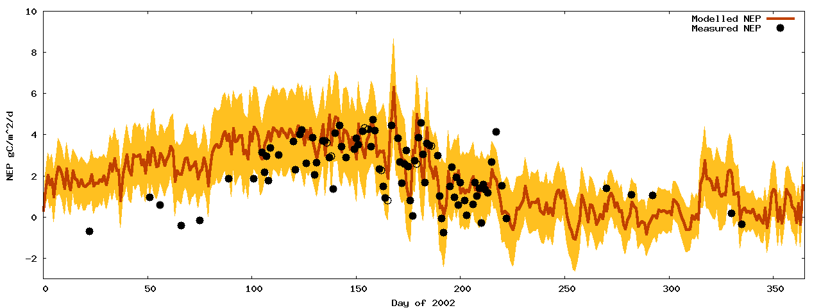
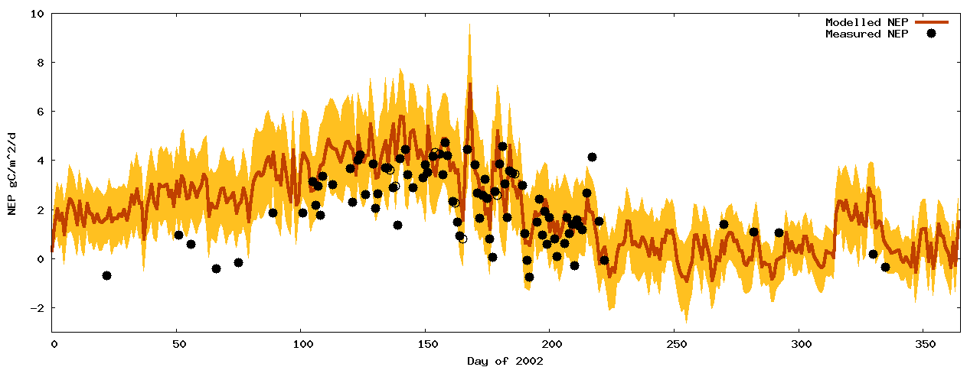
Quaife et al. 2008: NEP – Site2 (intermediate) parameters, with/without DA
Model running at Site 2, Oregon
Site 1 model EO-calibrated at site 2 NEP observations from Site 2
Shows ability to spatialise

Slide 32
MacBean et al. 2018: Particle Filters
Propagation step:
X = m(X⁻) + Q
Analysis step:
e.g. Metropolis-Hastings

Slide 33
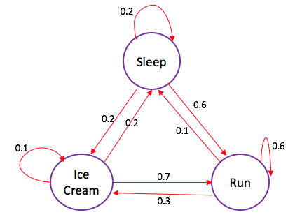
Markov Chain
Markov Process
probability of each event depends only on the state attained in the previous event.
Markov Chain
A countably infinite sequence, in which the chain moves state at discrete time steps, gives a discrete-time Markov chain (DTMC)

Slide 34
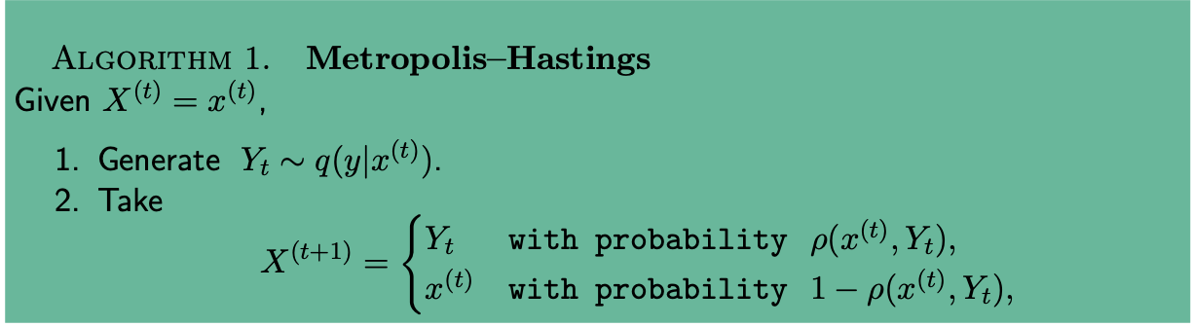

MacBean et al. 2018: Particle Filters
Consider transition from X(t) to X(t+1)
q: proposal kernel
Acceptance ratio
https://arxiv.org/pdf/1504.01896.pdf

Slide 35
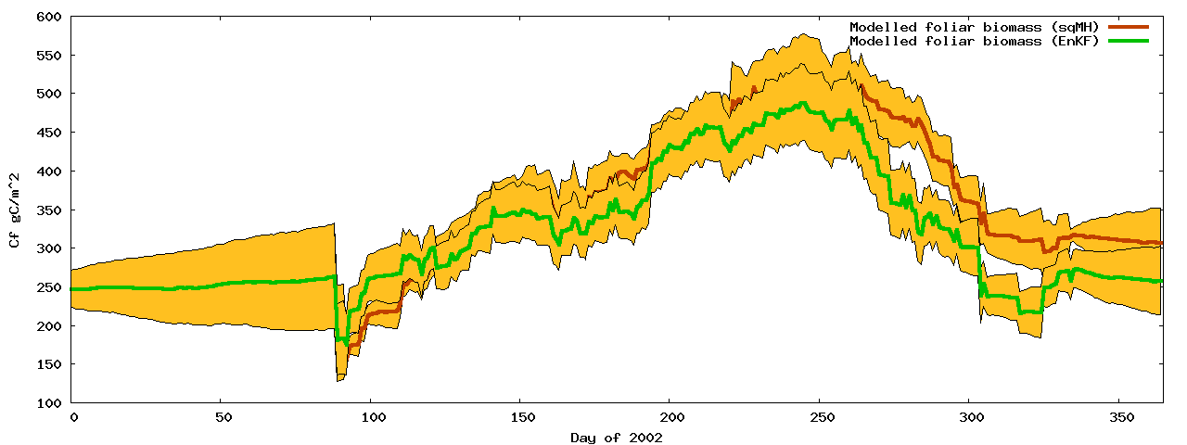
Particle Filters
No available observations

Slide 36
Particle Filters
Fully Bayesian
No underlying assumptions about distributions
Theoretically the most appealing choice of sequential technique, but…
Our analysis show little difference with EnKF
Potentially requires larger ensemble
But comparing 1:1 is faster than EnKF

Slide 37
Sequential techniques
General considerations:
Designed for real time systems
Only consider historical observations
Only assimilates observations in single time step
Can lead to artificial high frequency components

Slide 38
Smoothers
Extension of sequential techniques
All observations effect every time step
Analogous to weighting on observations
[ smoothing-convolution / regularisation ]
Difficult to apply in rapid change areas

Slide 39
Variational techniques
Expressed as a cost function
Uses numerical minimisation
Gradient descent requires differential
Traditionally used for initial conditions
But parameters may also be adjusted

Slide 40
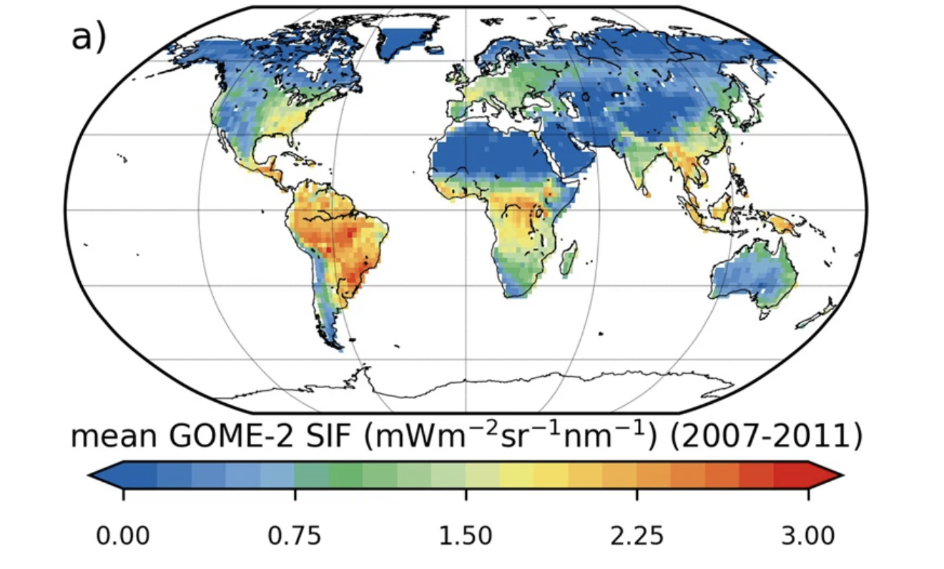
MacBean et al. 2018: Solar-Induced Fluorescence
GPP = a + b SIF

Slide 41
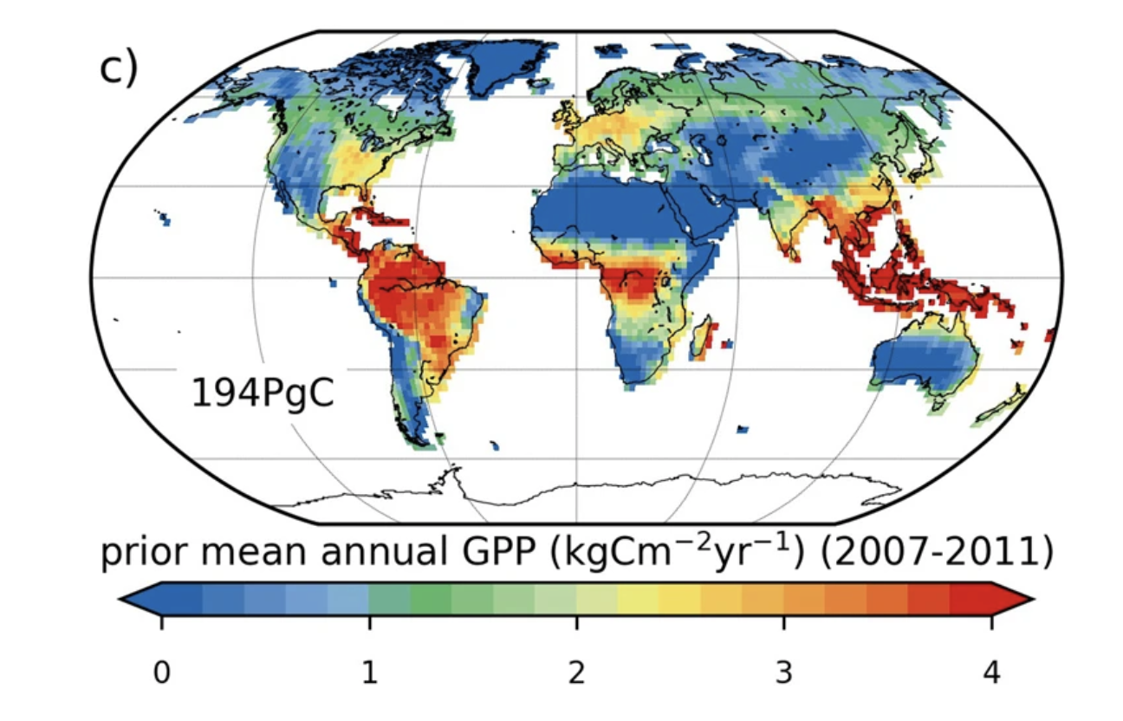
MacBean et al. 2018: Model GPP (prior)
GPP = a + b SIF

Slide 42
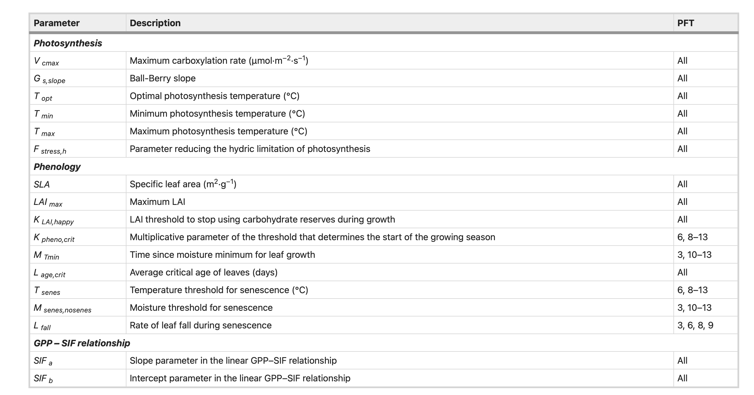

Slide 43
3DVAR
Background
J(x) = ( x-x⁻ ) P⁻¹ ( x-x⁻ )^{T} +
( y-h(x) ) R⁻¹ ( y-h(x) )^{T}
Observations

Slide 44
3DVAR
No temporal propagation of state vector
OK for zero order approximations
Unable to deal with phenology

Slide 45
4DVAR
J(x) = ( x-x⁻ ) P⁻¹ ( x-x⁻ )^{T} +
( y-h(x_{i}) ) R⁻¹ ( y-h(x_{i}) )^{T}
Σ_{i}
Time varying state vector

Slide 46
Variational techniques
Parameters constant over time window
Non smooth transitions
Assumes normal error distribution
Size of time window?
For zero-order case 3DVAR = 4DVAR
4DVAR for use with phenology model
Absence of Q - propagation of P?

Slide 47
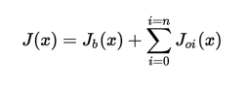
Variational data assimilation: strong constraint
Cost function minimisation
Multiple obs constraints
Plus prior
Strong constraint:
Prediction must be a valid model state
‘trust the model’

Slide 48
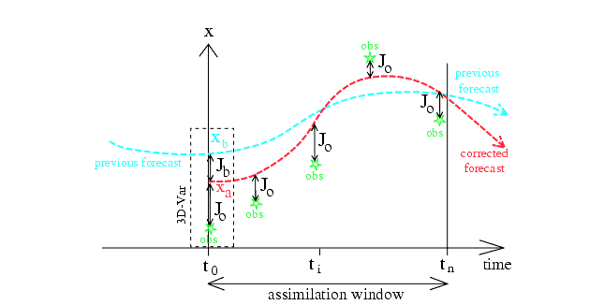
Variational data assimilation: strong constraint
Notes:
Figure from Bouttier and Courtier (1999) … should be self evident, but discuss with students. Mention 4D VAR … ie lots of these things happening over 3D space. Note that *normally* what is done is to adjust the initial conditions, eg in NWP. The ‘prior’ here is from a previous model run, or sometimes a climatology (average). Discuss advantages/disadvantages of strong constraint (trust the model … can correct for short term differences)

Slide 49
OCHIDEE with SIF
See applications of DA in notes
State-of-the-art: MacBean et al. 2018
Orchidee
French DGVM
Data for DA
GOME SIF

Slide 50
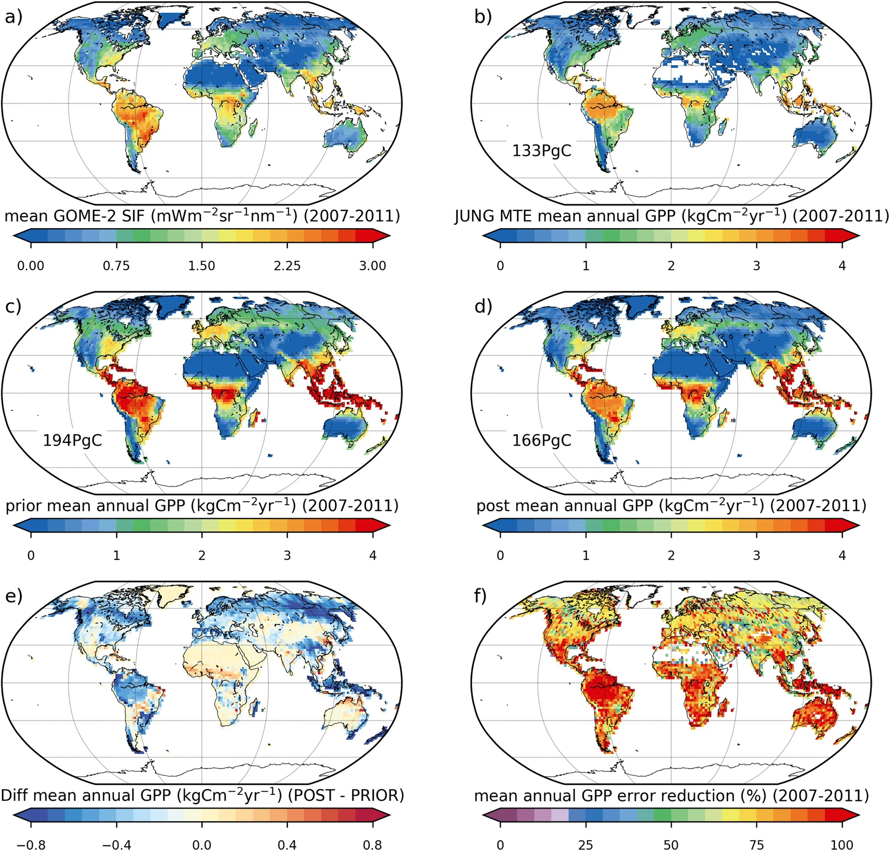
Notes:
83% reduction in GPP uncertainty

Slide 51
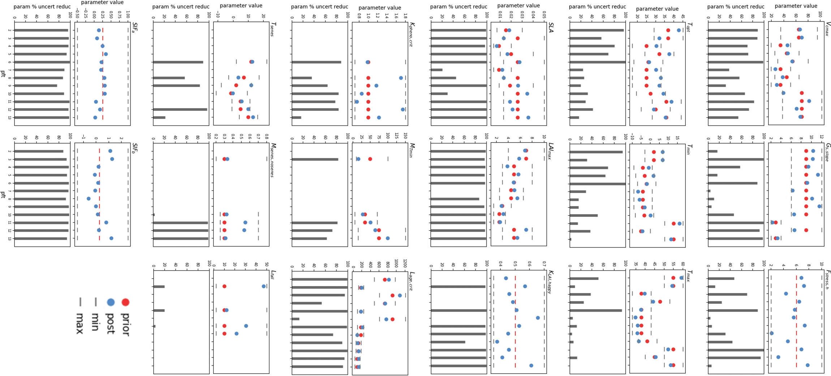
Model parameter

Slide 52
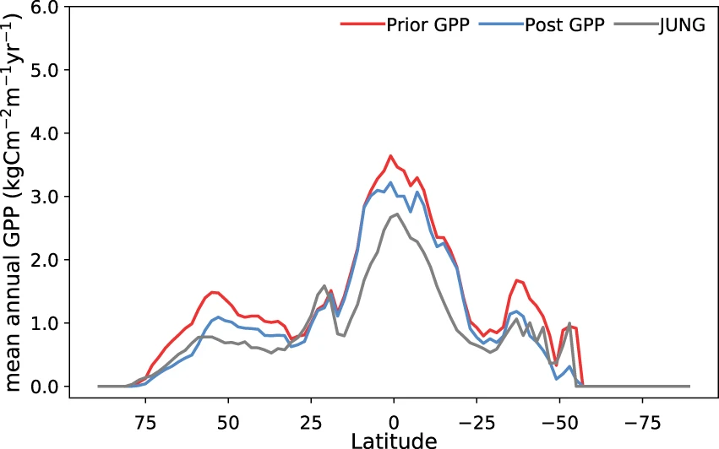
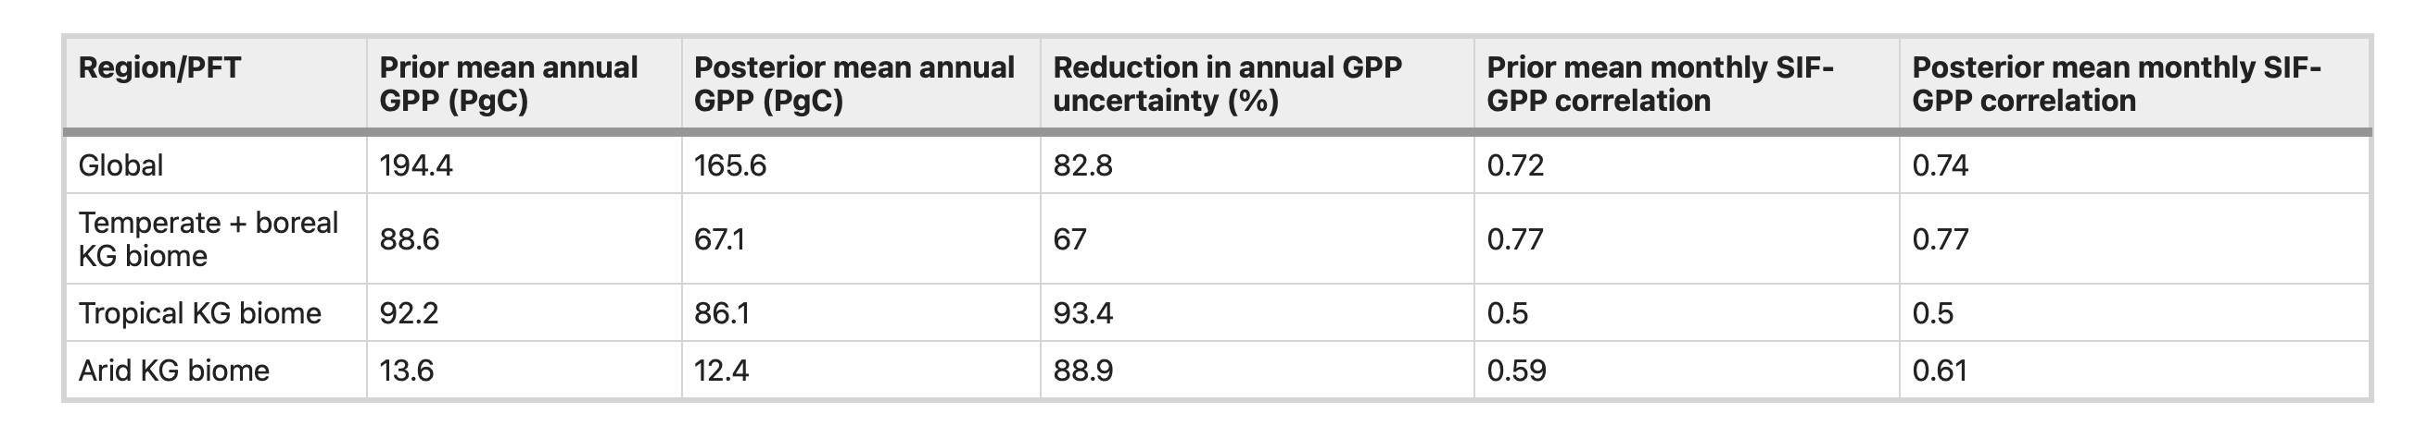

Slide 53
Crop yield example
Variational DA
See: https://www.geog.ucl.ac.uk/research/research-projects/sentinels-of-wheat

Slide 54
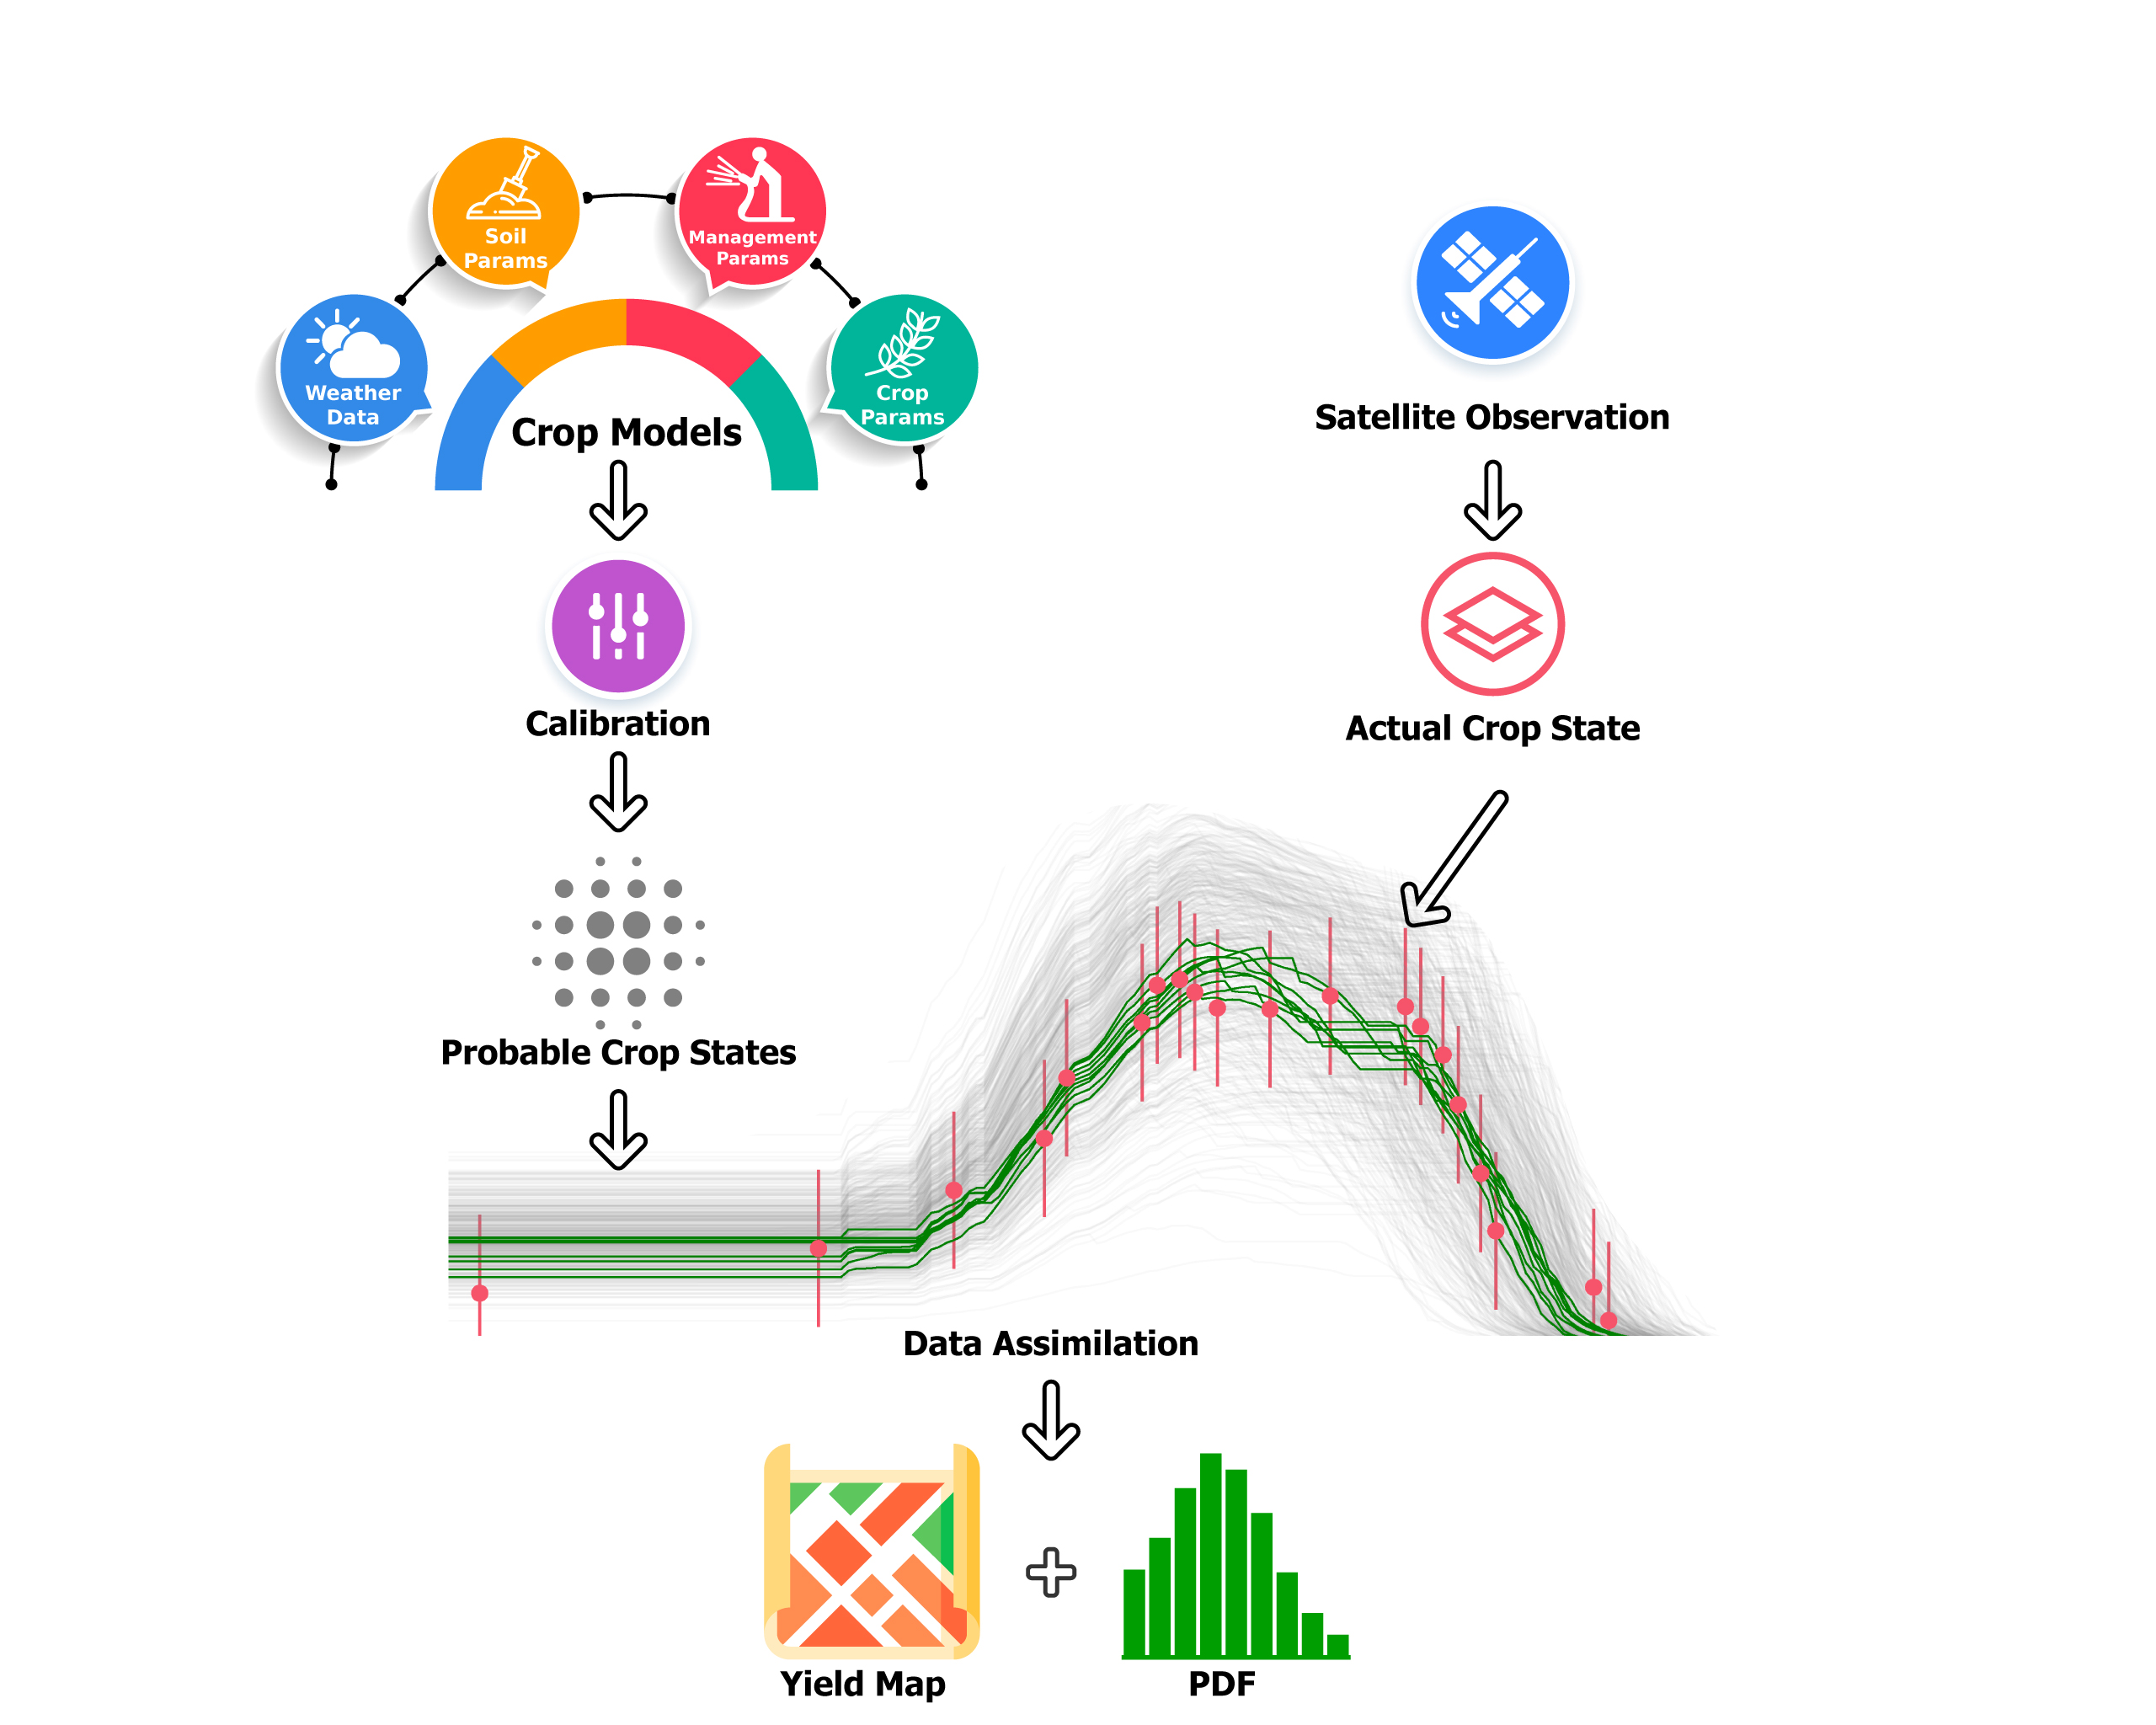
Overview of method
Use WOFOST crop model

Slide 55
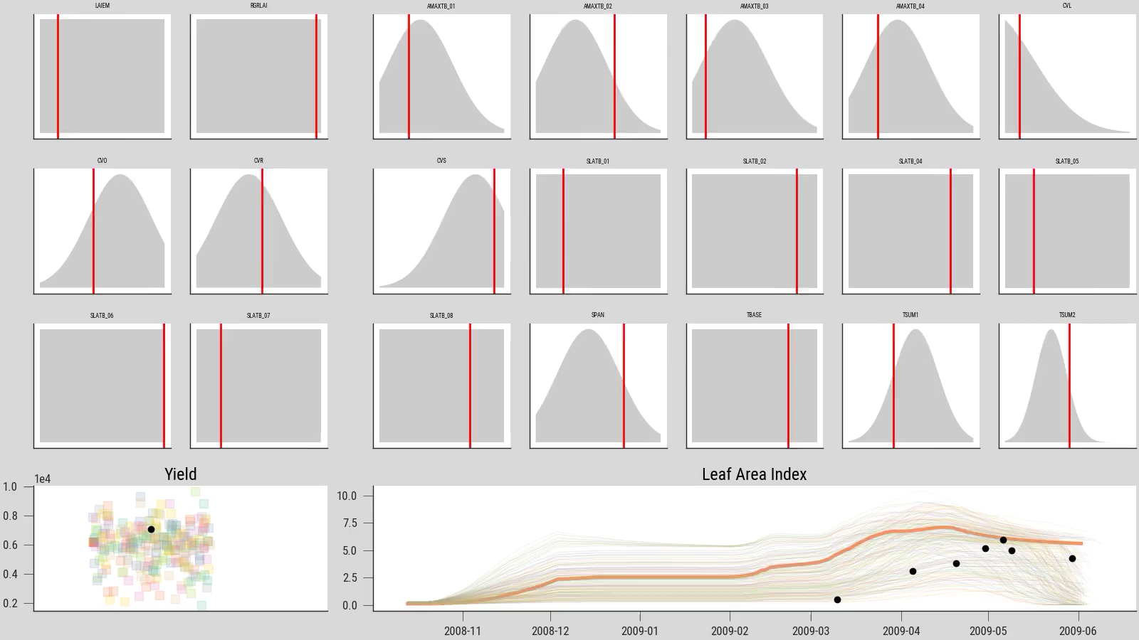
Information sources: calibrated growth/yield model

Slide 56
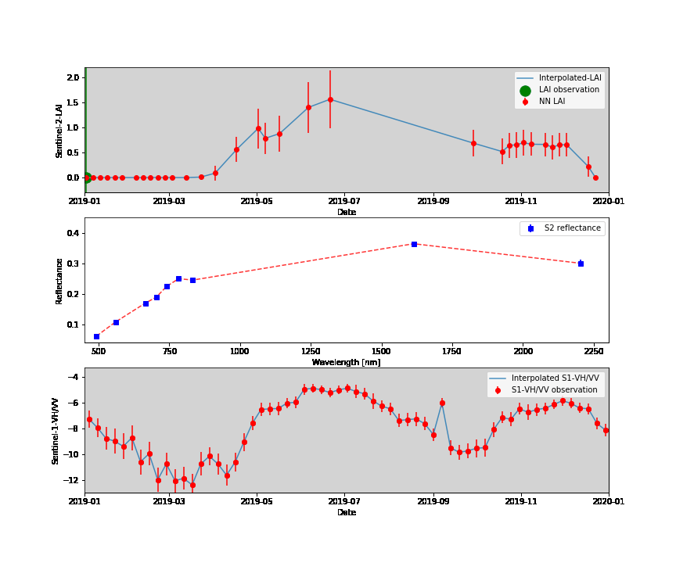
Information sources: biophysical parameters from satellite Earth Observation (EO)
LAI
Sentinel 2
Sentinel 1

Slide 57
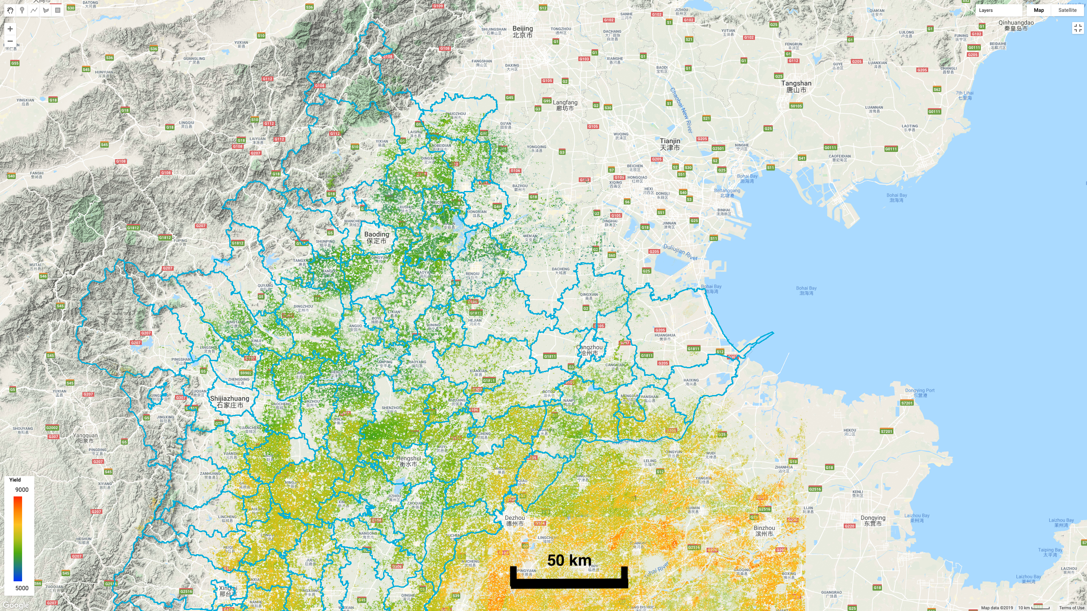
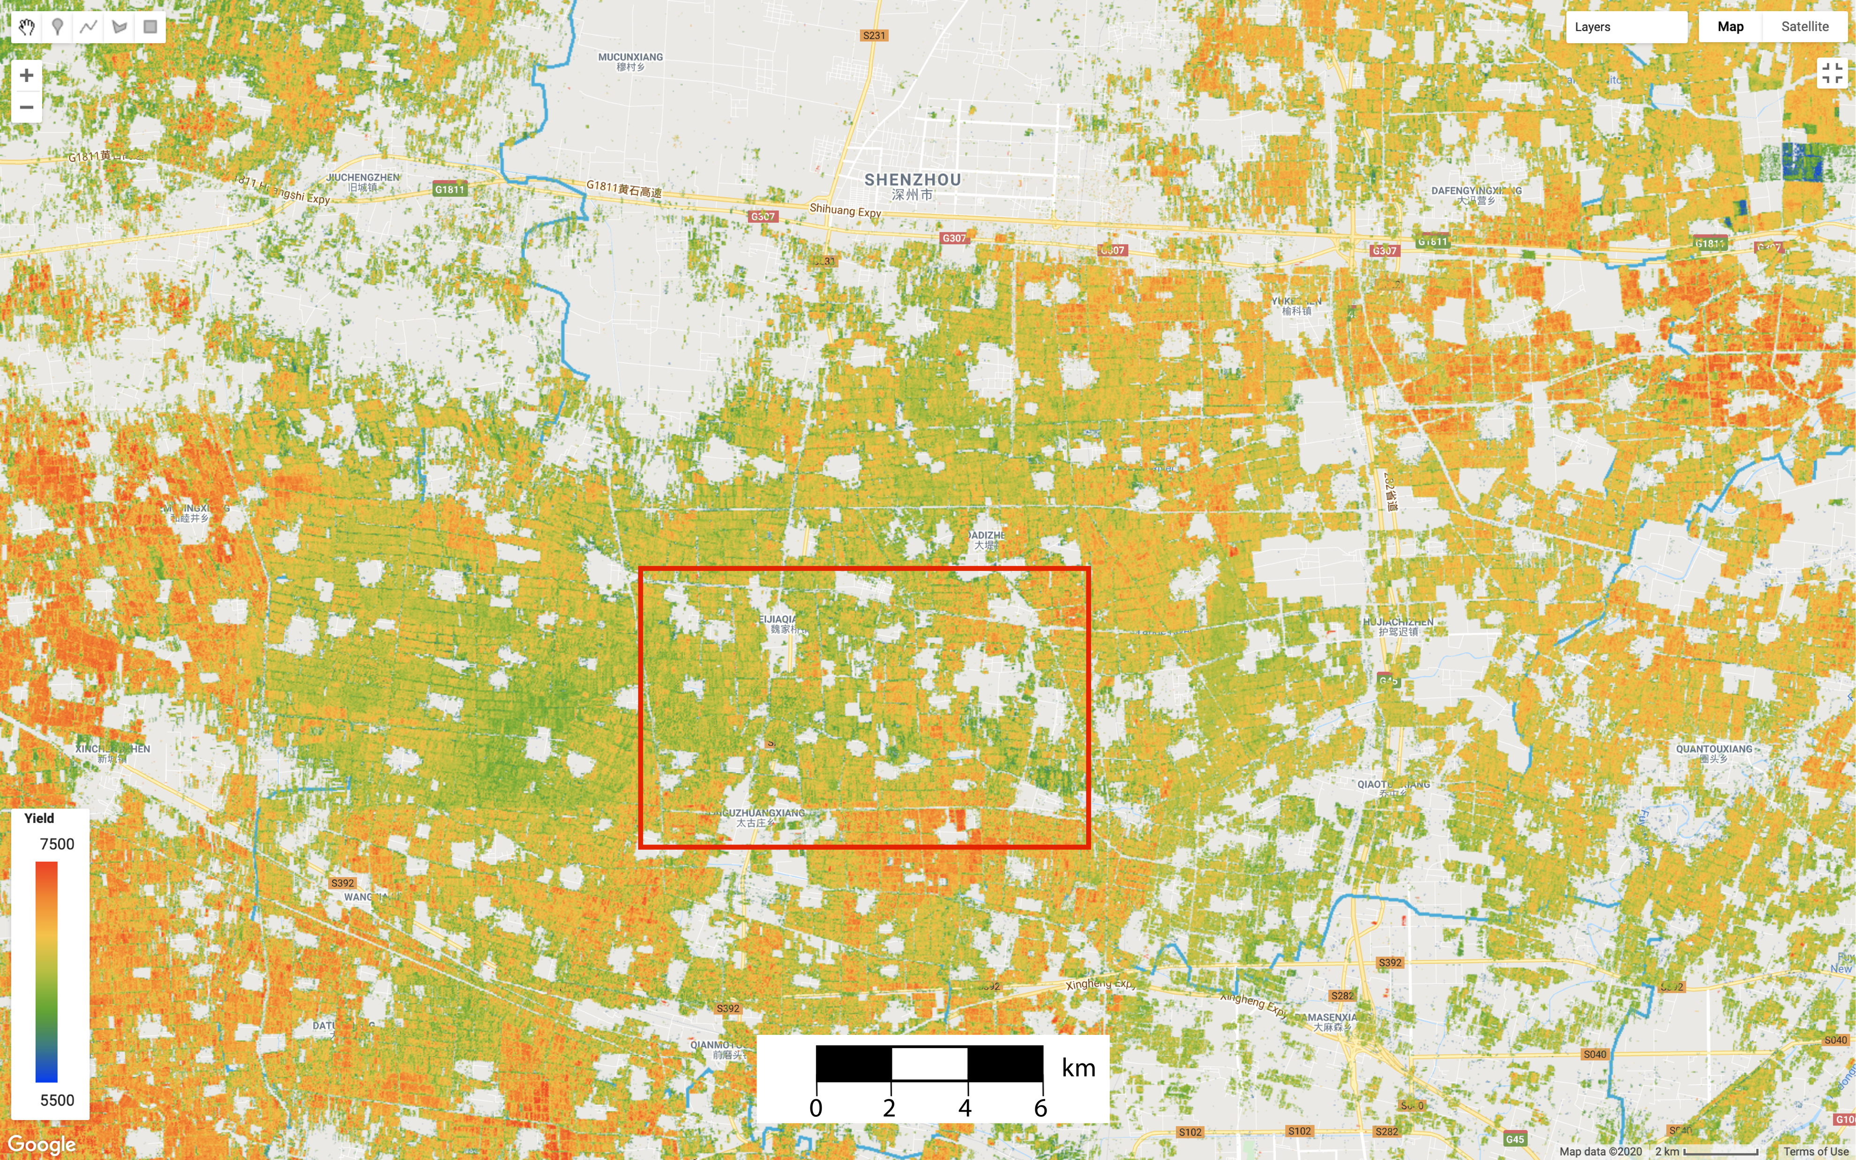
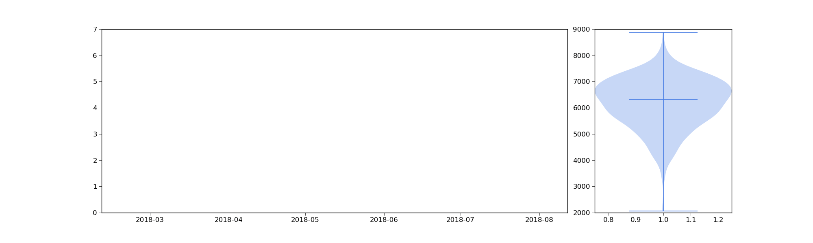
Data Assimilation
Result: Wheat yield: kg/ha
on
Google Earth Engine

Slide 58
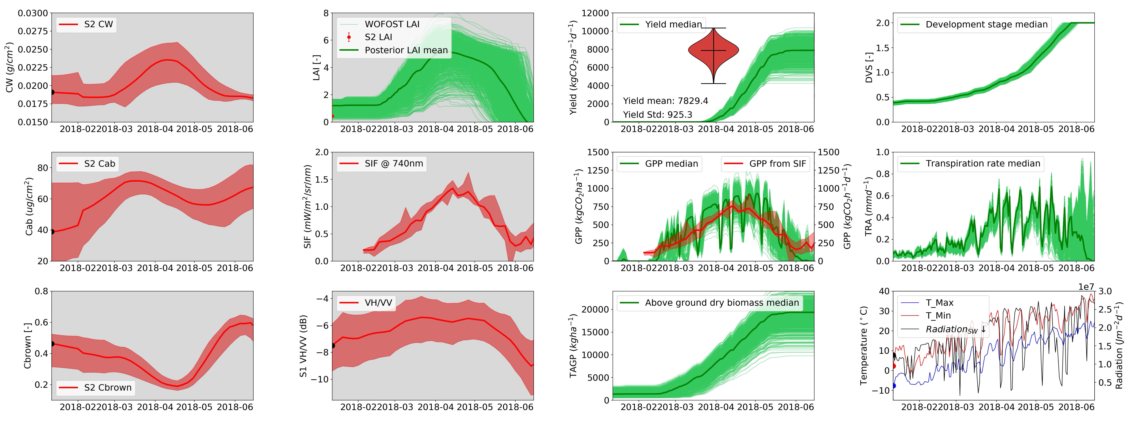


Other model outputs and measurements

Slide 59





Yield estimation flowchart
Initial (uninformative)
a priori crop parameter distribution
Regional crop field measurements
incl. yield
CAMS or other
weather drivers
Agrometeorological
Crop growth and yield model
A priori crop parameter distribution
WOFOST
Crop growth and yield model
MCMC solver
A priori yield ensembles
A priori LAI ensembles
Step 2: per weather cell ensemble generation
CAMS or other
weather drivers
Step 1: Crop model calibration
A posteriori yield ensembles
Step 3: per pixel solver
EO-derived LAI
time series
solver
A posteriori crop parameter distribution
Step 4: yield map
Update with observations (DA)

Slide 60
Data assimilation
What is DA?
What does DA do?
Examples:
Toy model
General DA concepts
Quaife et al. 2008
Sequential technique – Kalman Filter
MacBean et al. 2018 (Orchidee, SIF)
Variational technique – using cost functions

